Slide 1

Evaluating the effectiveness of using Large Language Models for the development of concept sets.
Joel Swerdel, PhD MS MPH^{1,2}, Dmytro Dymshyts MD^{1,2}, Anna Ostropolets MD PhD^{1,2}, Azza Shoaibi, PhD^{1,2}, Patrick Ryan, PhD^{1,2}, and Martijn Schuemie PhD^{1,2}
¹Johnson & Johnson, Titusville, NJ USA; ²Observational Health Data Sciences and Informatics (OHDSI), New York, NY, USA

Slide 2
Disclosures
Joel Swerdel, Dmytro Dymshyts, Anna Ostropolets, Azza Shoaibi, Patrick Ryan, and Martijn Schuemie are employees and shareholders of Johnson & Johnson.

Slide 3
Background
When developing phenotype definitions for health conditions, one of the first steps is to develop the list of codes used to determine the phenotype.
In OHDSI, health condition standard codes are usually SNOMED concepts mapped from diagnosis source codes (such as ICD-10-CM) used in the native data.
Selected concepts are then grouped into concept sets
Our current method for creating concept sets for phenotype development is inefficient, subjective, and inconsistent.

Slide 4
Objective
The objective of this study was to evaluate the use of Large Language Models (LLMs) for the selection of appropriate condition codes for concept sets used in phenotype algorithms.

Slide 5
Methods

Slide 6
Using the LLM to adjudicate concepts for a concept set
We used the LLM to adjudicate whether a concept belongs in a concept set for a clinical idea.
Example: does “Coronary occlusion” (suggested concept) belong in a concept set for “Acute Myocardial Infarction” (clinical idea)
The LLM was prompted to tell us whether “greater than 95% of patients with Coronary occlusion have Acute Myocardial Infarction”

Slide 7
Process Steps
Find starting concept from SNOMED
e.g., Acute Myocardial Infarction,
Concept ID = 312327
Create a list of the starting concept, descendants, and PHOEBE recomendations
Define Clinical idea
e.g., Acute Myocardial Infarction
Parse through LLM-selected concepts and create a new list of “> 95%” concepts and descendants
Prompt the LLM with each new concept in the list for analysis
Prompt the LLM with each concept in the list for analysis
Create final list of all
“> 95%” concepts
Post concept set to ATLAS

Slide 8
Methods
We tested the LLM process on 15 health conditions
Acute health conditions such as acute myocardial infarction
Chronic health conditions such as plaque psoriasis
For each condition, we created a human-adjudicated concept set developed through a collaboration of at least two researchers knowledgeable in concept set development.
These concept sets were the “reference standard” to be used for comparison with the LLM-adjudicated concept sets.

Slide 9
Methods (cont.)
For this study we used the licensed Johnson & Johnson version of the OpenAI LLM, (OpenAI Model GPT-4o, trained through October 2023).
Procedural calls to the application programming interface (API) for the LLM were made using the R platform.

Slide 10
Evaluation
Concept Evaluation:
1) The number of common concepts in the LLM and human generated concept sets
2) The number of concepts only in the LLM generated concept set
3) The number of concepts only in the human generated concept set
Subject Evaluation:
Cohort comparison using cohorts based on the LLM and human-generated concept sets.
Used the Merative Commercial Claims and Encounters (CCAE) database.
1) The number of common subjects in the LLM and human generated concept set cohorts
2) The number of subjects only in the LLM generated concept set cohorts
3) The number of subjects only in the human generated concept set cohorts

Slide 11
Results

Slide 12
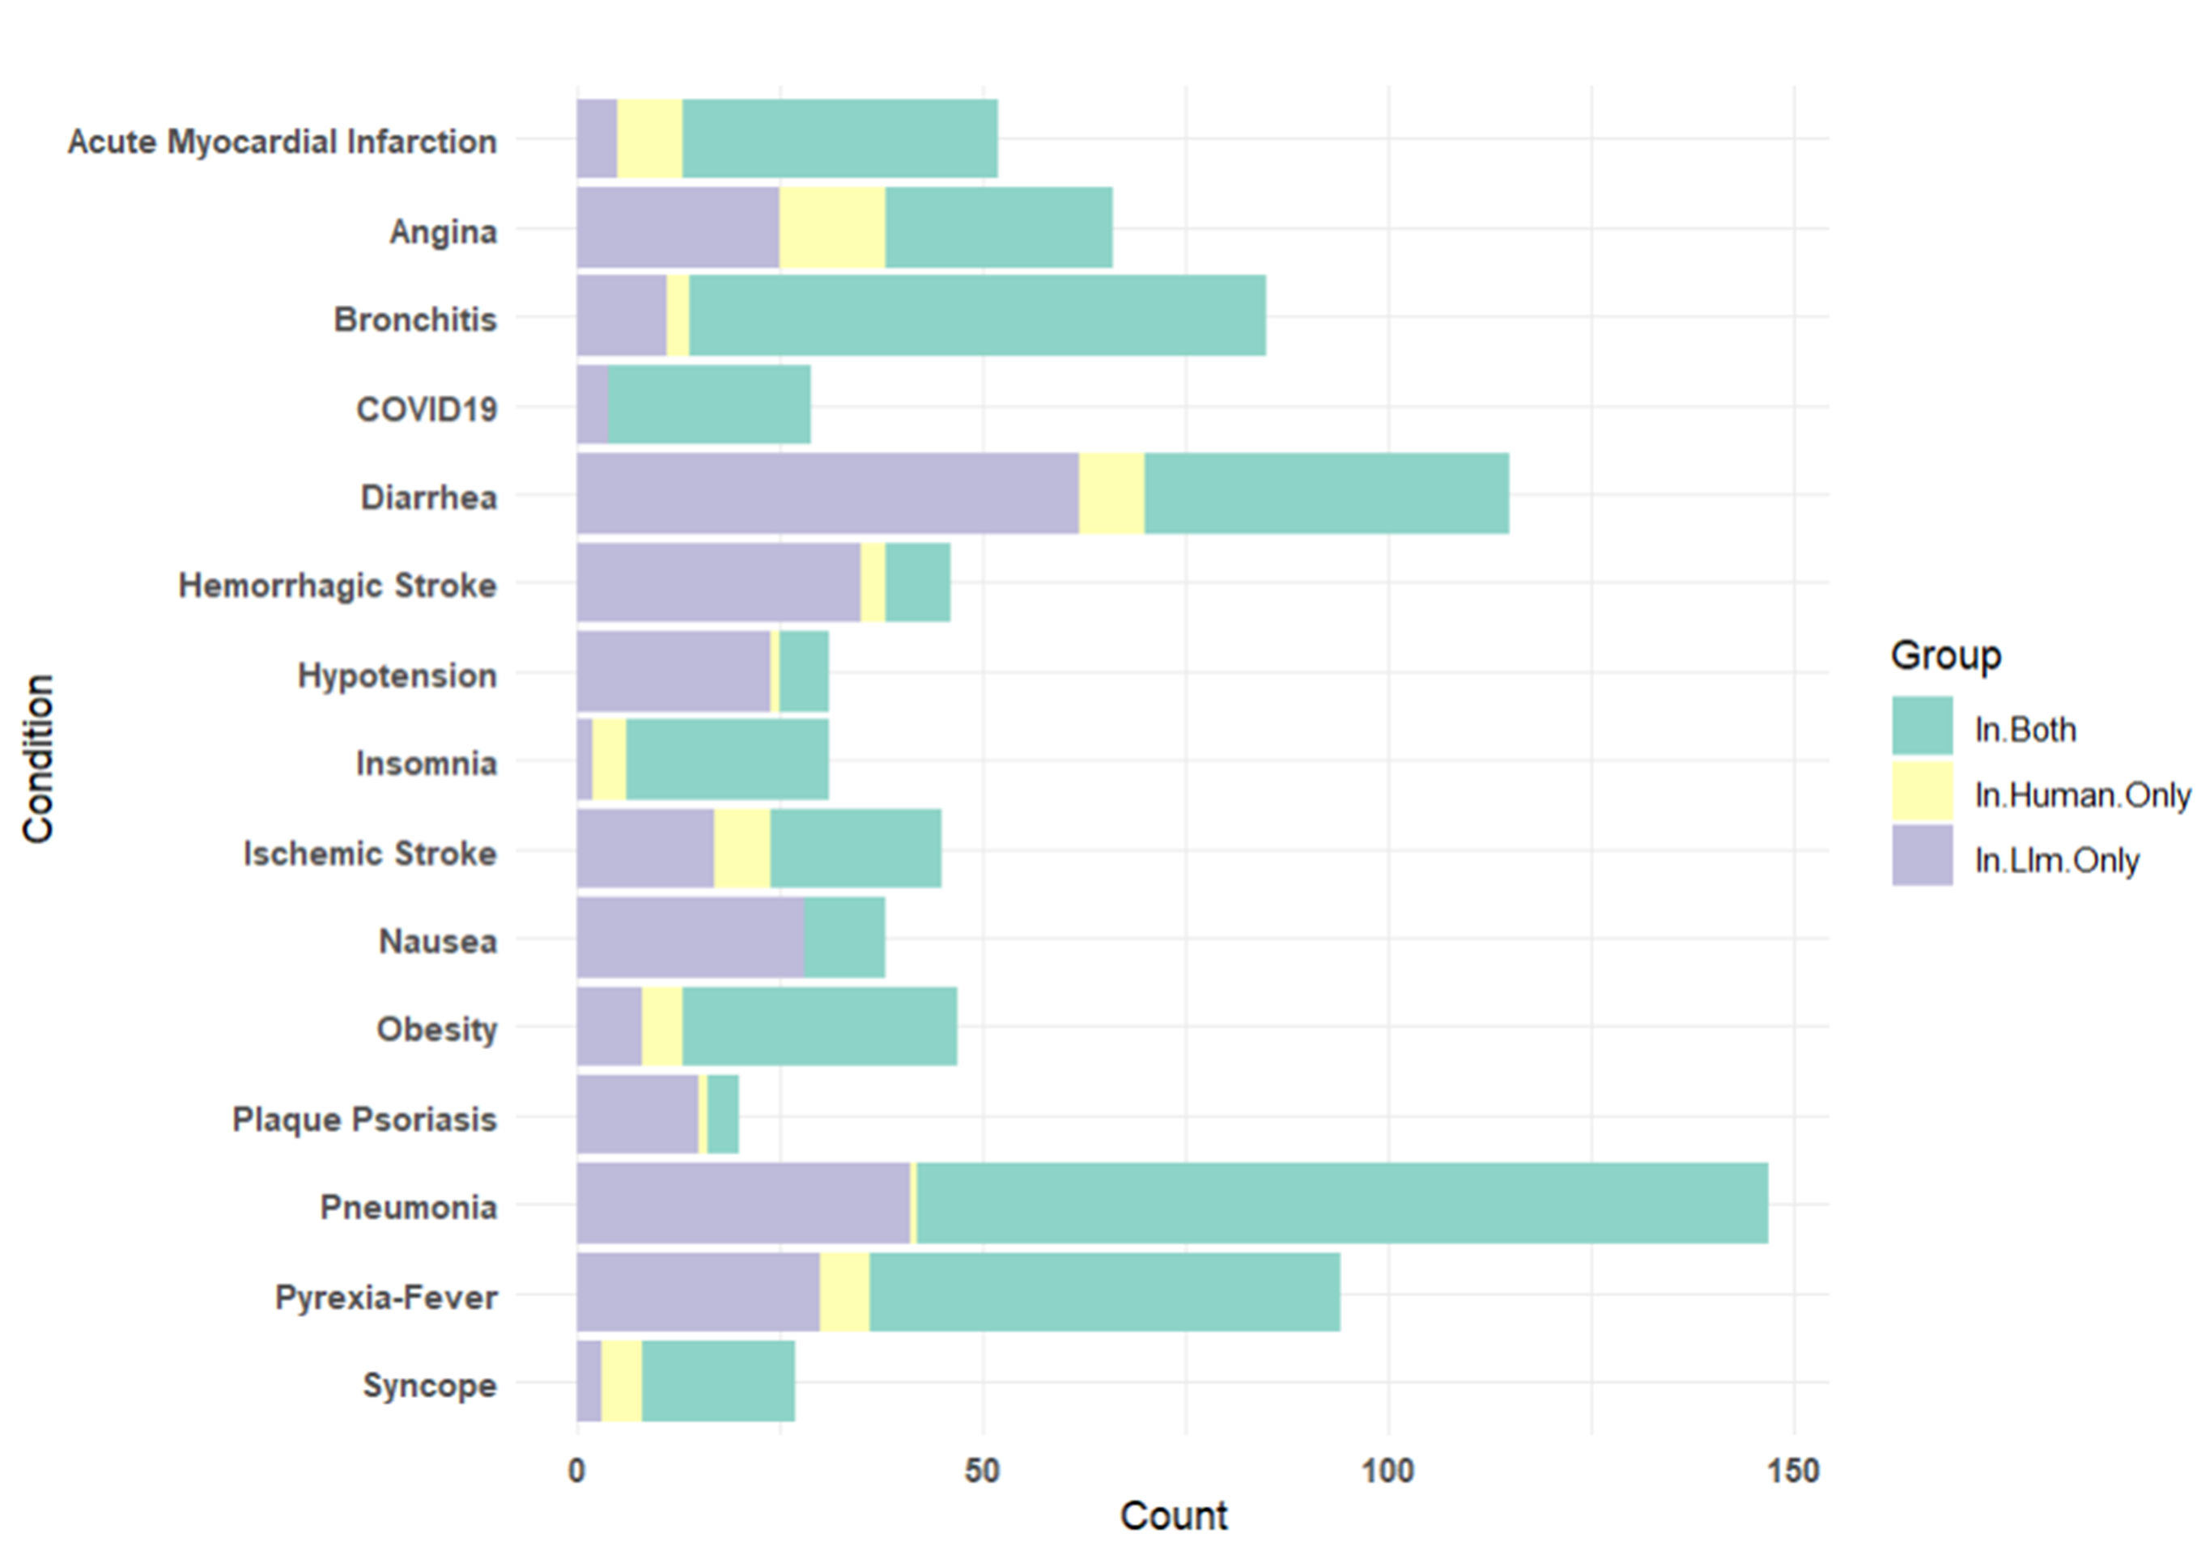
Concept Comparison
The majority of concepts were shared by the human and the LLM adjudicated concept sets. (10 conditions/15 total conditions)
In the other five conditions, the LLM determined more concepts than were overall shared.

Slide 13
Example Errors – LLM vs. Human for Obesity
 | False Negatives | False Positives
LLM | Obesity in mother complicating childbirth | Increased body mass index
 | Childhood obesity | Follow-up obesity assessment
Human | Obesity monitoring | Localized adiposity
 | Has seen dietitian – obesity | Fat pad syndrome

Slide 14
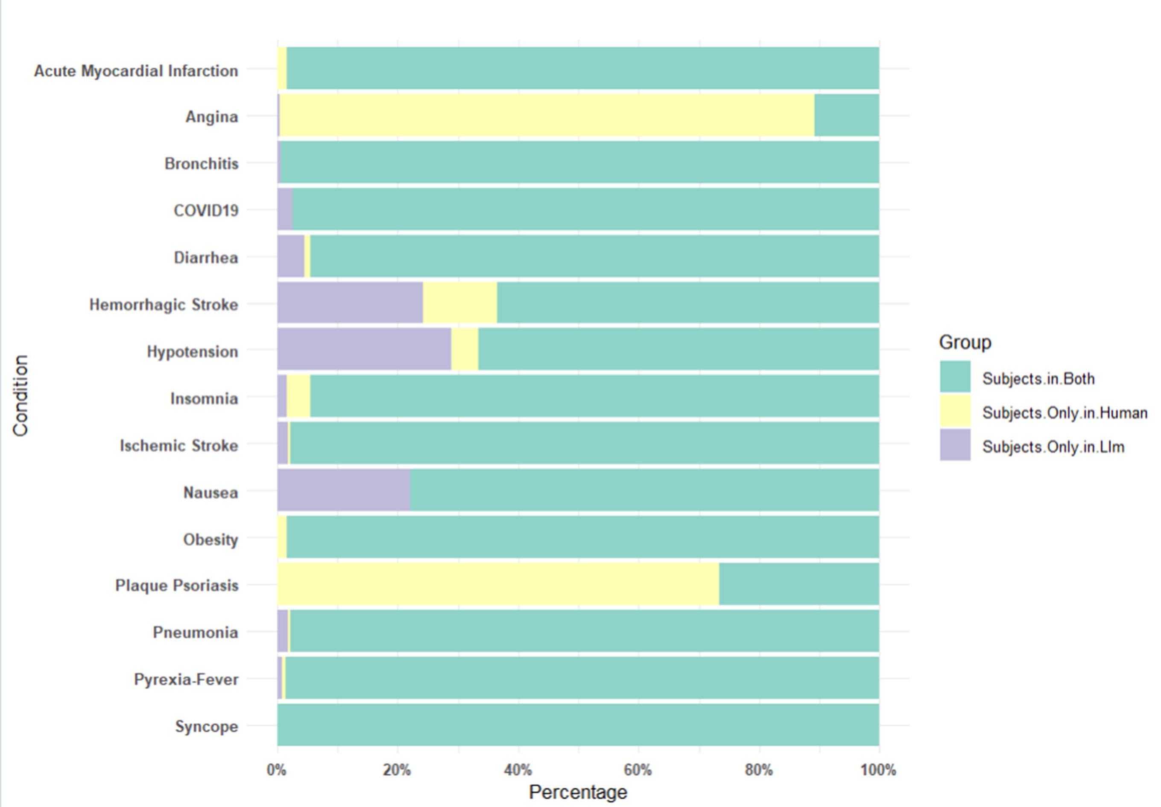
Subject Comparison
In 10 conditions, the LLM and human created similar subject counts
In 2 conditions, the human concept set had more subjects. Example: Angina - human inclusion of the code for concept of “chest pain”. The LLM argued that most people with chest pain do not have angina.
In 3 conditions the LLM had more subjects than the human concept set. Example: Nausea: LLM included vomiting where it argued that 95% or greater of the subjects with vomiting also have nausea.

Slide 15
Conclusions
In our use of Large Language models to adjudicate whether concepts belong in a concept set, we found many differences in those generated by the LLM compared to those generated by humans.
We found that it is valuable to use the LLM to adjudicate concepts for concept sets as a starting point to help reduce the recommended concepts by PHOEBE and speed development.
Further evaluation is required to determine whether the use of LLM constitutes a significant improvement in quality in the overall phenotype development and evaluation process.

Slide 16
Thank you!
Questions?
Come to Poster
604

Slide 17

Want some real excitement?!?
Come to the Phenotype Development Workshop
Thursday 8am!
(actual
participants)

